Slide 1



GHG Emission Prediction
Vaibhav Dnyaneshwar Patil
AICTE Student ID: STU6688de77864011720245879
AICTE Internship ID: INTERNSHIP_1748923002683e727a876ea

Slide 2

Learning Objectives
Understand the End-to-End Workflow of Predictive Modeling.
Apply Data Scaling Techniques for Model Optimization.
3. Perform Hyperparameter Tuning for Model Improvement.
GOAL
Deploy Machine Learning Models Using Streamlit.
Enhance Problem-Solving and Analytical Thinking.

Slide 3
Tools and Technology used
Programming Language – Python
Environment – Google Collab
Dataset- .xlsx
Libraries – numpy, Streamlit, Pandas, Matplotlib.

Slide 4
Methodology
Data Collection
Preprocessing
EDA visualization
Model Selection
Training the Model
Evaluation
Deploy and stream

Slide 5
Problem Statement:
The rapid increase in greenhouse gas (GHG) emissions is a major contributor to climate change and global warming. Accurate forecasting of GHG emissions in upcoming years is essential for policy- makers, environmental agencies, and engineers to design effective strategies for emission control and sustainability.
The challenge is to develop a predictive model that can estimate future GHG emissions based on historical data, such as industrial activity, energy consumption, GDP, and population. The model should be highly accurate to ensure reliable planning and decision-making.

Slide 6
Solution:
Data Collection
Use historical GHG emission datasets (e.g., from Kaggle, World Bank, EDGAR, or Climate Watch).
Features may include: year, population, energy consumption, industrial output, GDP, etc.
Data Preprocessing
Handle missing values, normalize data using StandardScaler/MinMaxScaler.
Feature engineering: Create new features or combine existing ones if needed.
Model Building
Train and test models:
  Linear Regression for baseline predictions.
  Random Forest Regressor to capture non-linear relationships and improve accuracy.
Use cross-validation and hyperparameter tuning (e.g., GridSearchCV) for optimization.
Model Evaluation
Measure performance using R² Score, RMSE, and MAE.
Choose model with the highest R² (ideally ≥ 0.99) and lowest error metrics.
Model Deployment
Deploy the final model using Streamlit to build an interactive web app where users can enter inputs
(e.g., year, energy use) and see predicted GHG emissions.
Gitlink : https://github.com/123gupta-prashasti/edunetFoundation.git

Slide 7
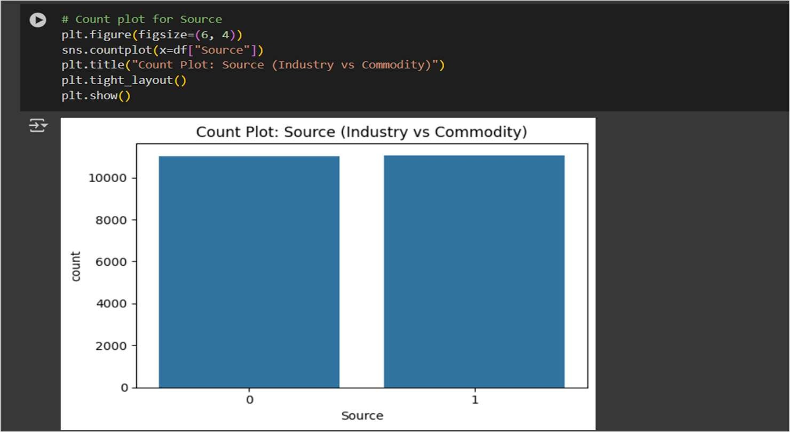
Screenshot of Output:

Slide 8
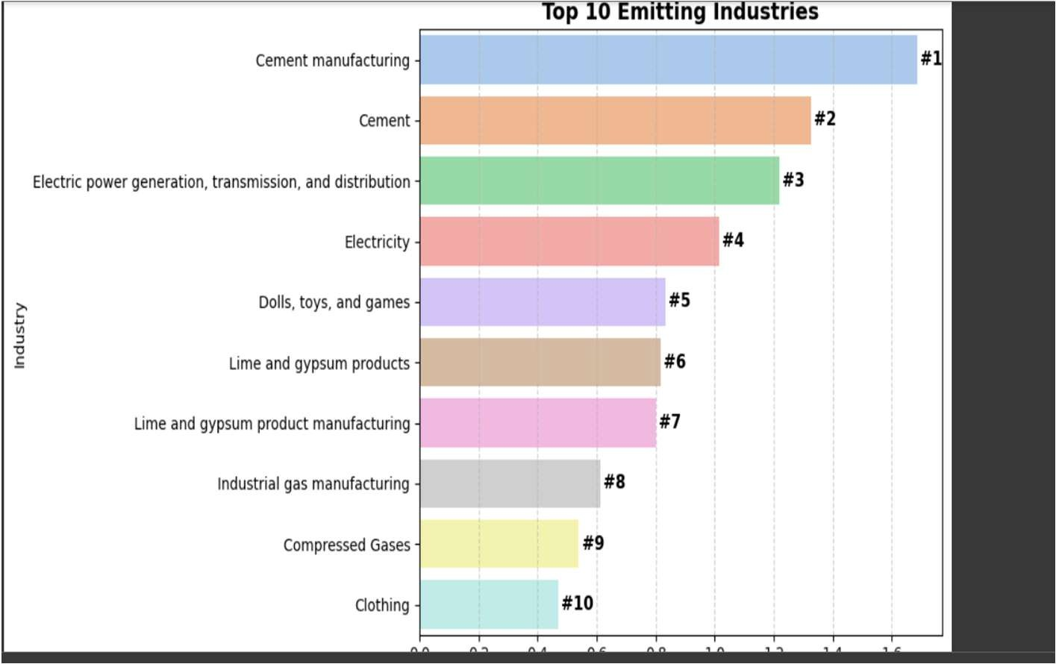
Screenshot of Output:

Slide 9
Conclusion:
Our analysis provides critical insights for policymakers and engineers to implement effective emission control strategies.
With proper mitigation measures, the predicted rise in emissions can be curbed significantly.
This project highlights the importance of data-driven decisions in tackling climate change.
Future work may involve real-time data integration, better feature engineering, and deploying the model using Streamlit for public and government use.

Slide 10
Thank You….!

